Slide 1
Operating System
Name: Maaz Mustafa
Roll No: 22P-9405
Sec: 4B

Slide 2
Topic : Multi-Threading in Nodejs

Slide 3
> Understand single-Threading
> Understand Multi-Threading

Slide 4
Node-server
Running on 8080 Port

Slide 5
req
Node-server
Running on 8080 Port

Slide 6
req
Node-server
Running on 8080 Port
Req compute 20B
sum

Slide 7
req1
Node-server
Running on 8080 Port
Req2 compute 20B
sum
req3

Slide 8
req1
Node-server
Running on 8080 Port
Req2 compute 20B
sum
req3

Slide 9
> Request 3 or upcoming req not respond until
> Previous Request will not complete
> Main thread is Blocked

Slide 10
Solution ??

Slide 11
We create new Thread
Assign this CPU-intensive task to this Thread
So it execute independently without blocking main Thread

Slide 12
req1
Node-server
Running on 8080 Port
New thread
Req2 compute 20B
sum

Slide 13
req1
Node-server
Running on 8080 Port
New thread
compute 20B sum

Slide 14
req1
Node-server
Running on 8080 Port
New thread
req3
compute 20B sum

Slide 15
And so on

Slide 16
Node-server
Running on 8080 Port

Slide 17
req
Node-server
Running on 8080 Port

Slide 18
req
Node-server
Running on 8080 Port
req

Slide 19
req
Node-server
Running on 8080 Port
req
req

Slide 20
What If ? Number of user increase
Let suppose 1000 user want to serve at a time

Slide 21
> Load increase in server
> User have to be waiting
> System slow down

Slide 22
Go To IDE

Slide 23
Solution.
> we use cluster in Node Js

Slide 24
instance1
Node server
instance2
Node server
Load balancer
Node server
instance3
Node server

Slide 25
req1
instance1
Node server
instance2
Node server
Load balancer
instance3
Node server

Slide 26
req1
instance1
Node server
instance2
Node server
Load balancer
instance3
Node server

Slide 27
req1
instance1
Node server
req2
instance2
Node server
Load balancer
instance3
Node server

Slide 28
req1
instance1
Node server
req2
instance2
Node server
Load balancer
instance3
Node server

Slide 29
req1
instance1
Node server
req2
instance2
Node server
Load balancer
instance3
Node server
req3

Slide 30
req1
instance1
Node server
req2
instance2
Node server
Load balancer
instance3
Node server
req3

Slide 31
What if 4th Req send??

Slide 32
round-robin approach

Slide 33
req4
req1
instance1
Node server
req2
instance2
Node server
Load balancer
instance3
Node server
req3

Slide 34
req4
req1
instance1
Node server
req2
instance2
Node server
Load balancer
instance3
Node server
req3

Slide 35
Node JS Architecture.
“Single Threaded Event Loop”

Slide 36
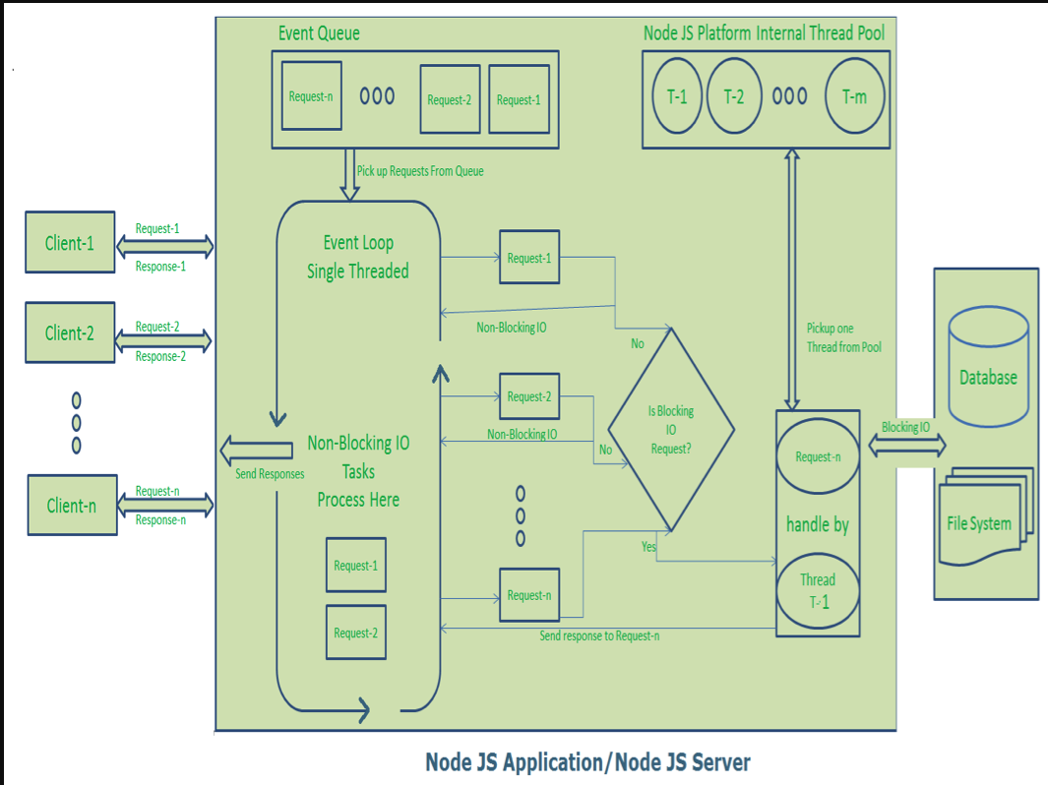

Slide 37
Clients Send request to Web Server.
Node JS Web Server receives those requests and places them into a Queue. It is known as “Event Queue”.
Node JS Web Server internally has a Component, known as “Event Loop”. indefinite loop to receive requests and process them.
Even Loop checks any Client Request is placed in Event Queue. If no, then wait for incoming requests for indefinitely.
If yes, then pick up one Client Request from Event Queue
Starts process that Client Request

Slide 38
If that Client Request Does Not requires any Blocking IO Operations, then process everything, prepare response and send it back to client.
If that Client Request requires some Blocking IO Operations like interacting with Database, File System, External Services then it will follow different approach
Checks Threads availability from Internal Thread Pool
Picks up one Thread and assign this Client Request to that thread.
That Thread is responsible for taking that request, process it, perform Blocking IO operations, prepare response and send it back to the Event Loop

Slide 39
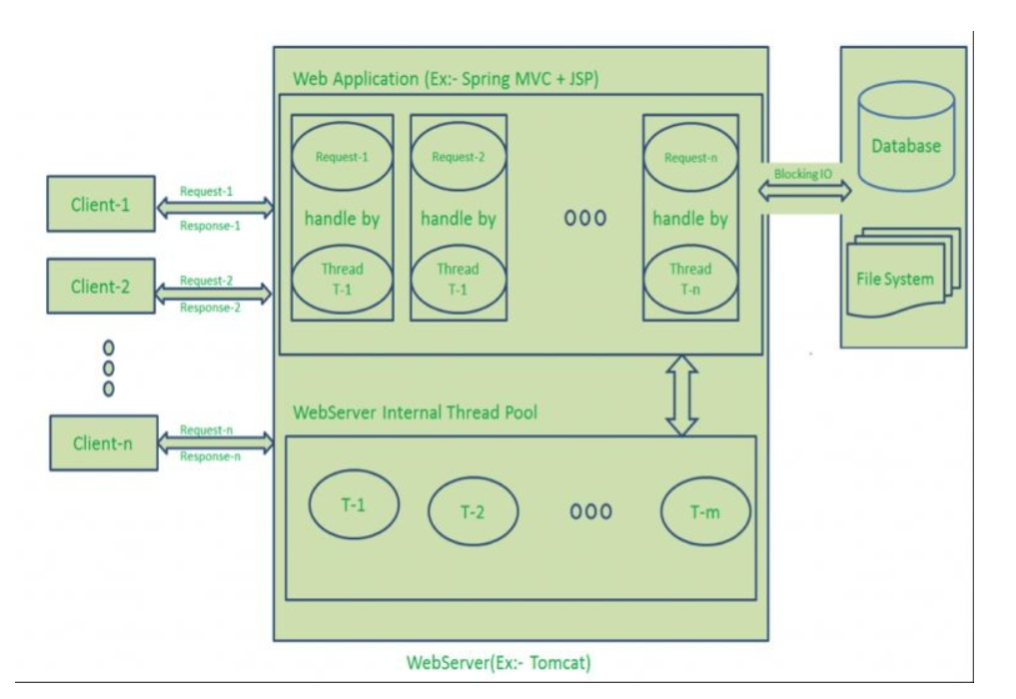
Traditional Web-server

Slide 40
Request/Response or “Multi-Threaded Request-Response” Model
Clients Send request to Web Server. Web Server internally maintains a limited thread pool to provide services to the client requests.
Web Server is in infinite loop and waiting for client incoming requests
Web Server pickup one client request and Pickup one thread from thread pool , Assign this thread to client request
This thread will take care of reading , processing client request, performing any blocking IO operations (if required) and send response to server . Server send back this response to their respective client

Slide 41
Drawbacks
Handling more and more concurrent client’s request is bit tough.
When Concurrent client requests increases, then it should use more and more threads, finally they eat up more memory.

Slide 42
Traditional Web-server

Slide 43
And so on
Go to IDE

Slide 44
Thanks

